Slide 1
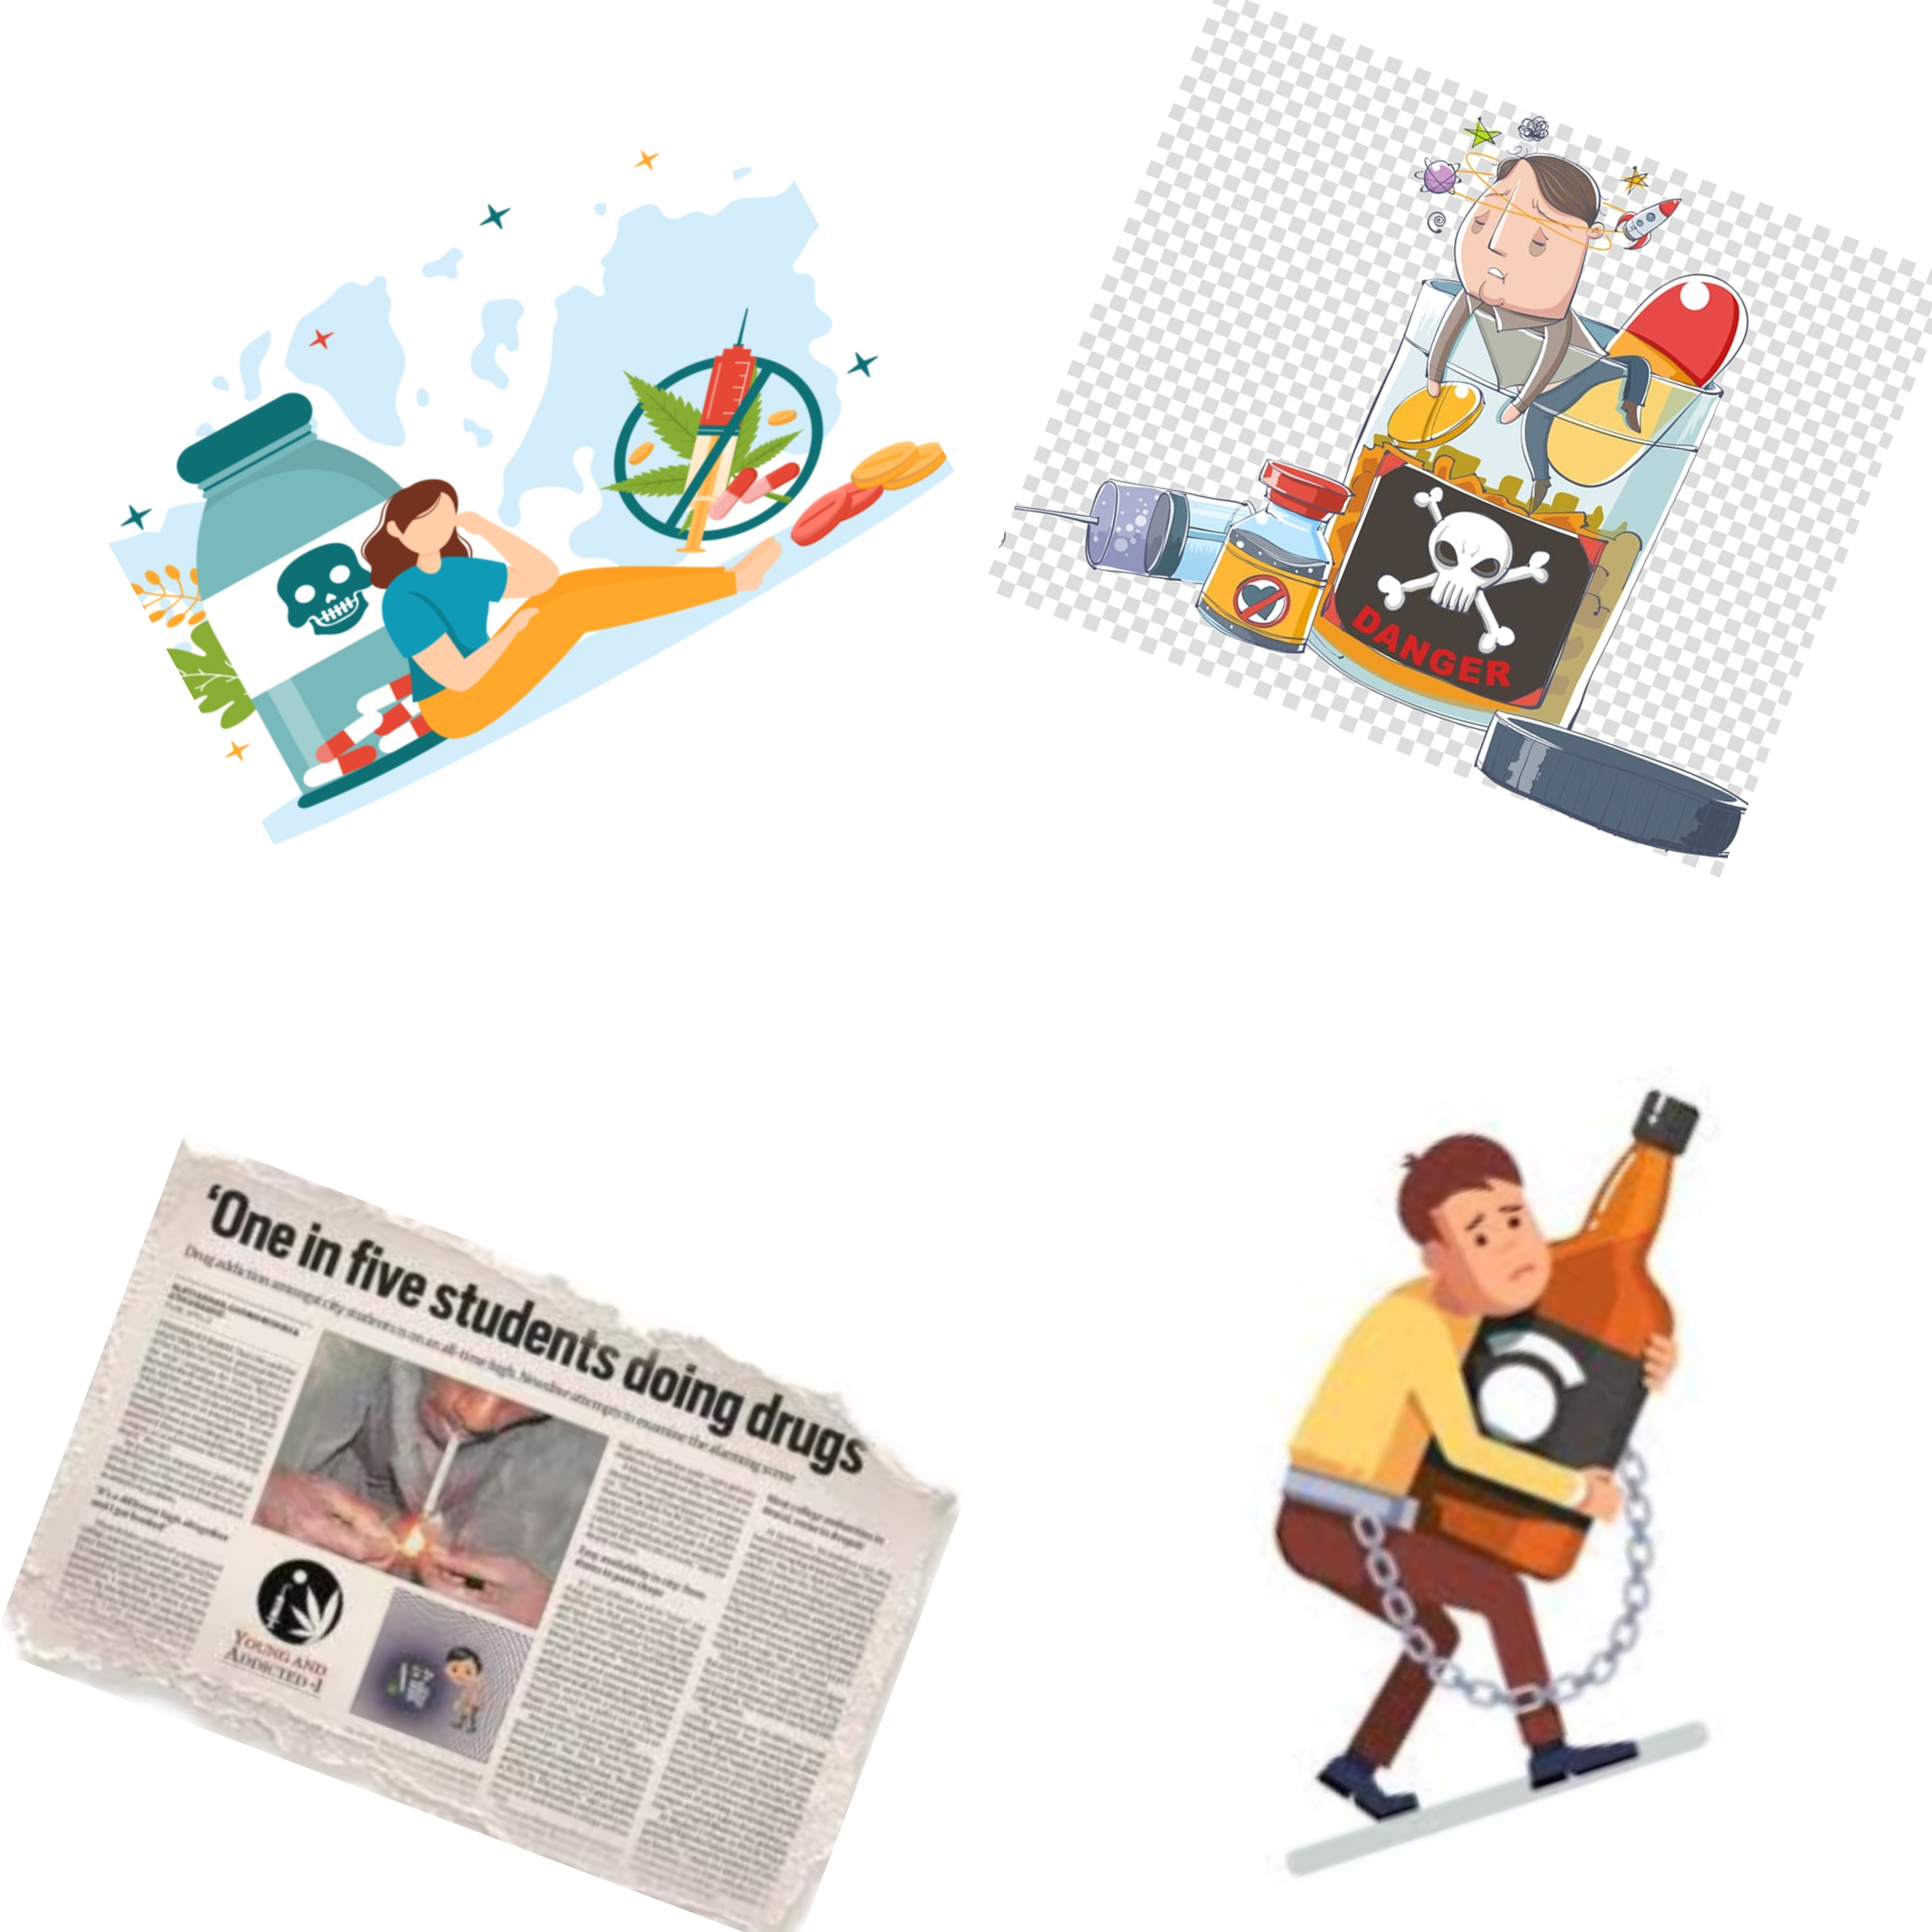
COP290 DESIGN PRACTICES
GAME FOR CHANGE
Submitted By:
Orin Pao (2022CS11130)
Akash Meshram (2022CS11627)

Slide 2
What’s the Social Cause:
The Social issue that we identified for gamification is ‘Drug Addiction’.
We decided to make a game on it as we had observed this issue around us.
Reasons for Drug Abuse:
Peer Pressure: Influence from friends.
Stress and Coping: Using drugs to manage stress or escape problems.
Easy Access: Availability and affordability of substances.
Impact of Drug Abuse:
Health Consequences: Health problems, addiction, overdose, and increased infectious diseases.
Social Consequences: Strained relationships, isolation, and financial problems.
Psychological Consequences: Impaired judgment, mood swings, anxiety, and depression.
Community Impact: Increased crime rates, burden on healthcare systems, and economic costs.

Slide 3
Design Choices.
Firstly we had to choose the programming language which we would be using for our game development and we decided to go with C++, as we are more used to it than Python or any other programming language. Also, we found out that Python was a bit slower in running the game so from the performance point of view as well we thought to move forward with C++.
In C++ we particularly used ‘Raylib’ and its derivative libraries for our game.
While thinking of the platform for which we wanted to design the game we wanted our game to be scalable and accessible so we didn’t go for Android or iOS application. We have created it for laptops only.
The choice of 2D v/s 3D was crucial as we initially thought of making a 3D game, but later realized that the efforts for the 3D game were way too high so we shifted to a 2D game.

Slide 4
Metrics
Programming Language: The language used by us, i.e. C++. We decided to use C++ because of its responsiveness and fast execution speed as compared to Python or any other language.
Originality of idea: We didn’t try to copy any game or even the idea of the game. The idea behind the game is unique and not taken from anywhere. Although the game that we had planned initially is not what we finally ended up with. The original idea was that our main character would be driving the drug-abused people to the hospital in a limited amount of time and the score would add up accordingly. We had also planned to make levels for this game in which the time constraint of taking addicted people to the hospital would become tougher as we move on to the next level.
Better speed: Our game has almost zero latency during the gameplay which again puts it in a better position than many others.
Extensive Map: The map we created closely resembles the campus of IIT Delhi, although the buildings and environment look way different the idea was to keep the setup to be based on our campus.

Slide 5
How did we proceed:
We first of all began by discussing the social issue we observed and then thought about how to gamify the idea. We identified various social issues like Pollution, Women safety, Corruption and so on. Then we thought about the gamification part about these issues and we realized that we would land up more or less on a trivial game. But then we thought to gamify the issue we can see very closely i.e. Drug addiction. This issue is also visible (although on a very small scale) to us in campus. So we finalized the issue, and then we began with the idea of saving the drug-abused people. Although because of time constraint we had to divert from our original idea.
Firstly we wanted to simulate our campus so we researched about how can we make a map of our campus. Since we had already decided to make a 2D game so we went with the creation of a top-down view of our campus. We used a software named ‘Tiled’ for this purpose which is a completely free software used for map creation.

Slide 6
How did we proceed:
By creating several tilesets and then positioning them in our map we finally made the map that we wanted to load in our game.
After this we wanted to show the back story of our main character, like why is he so interested in saving drug-abused people lying on the roadside. For creating the backstory we collected some photos of a young aged boy and then edited these pics to create a backstory. We used the online platform ‘Canva’ for merging the story components and adding dialogues of the characters.
After this we went on to make our main character, we first started with gimp for making the sprite of him, but later we found a free website named ‘Universal sprite generator’ for creating the sprite and then we used gimp for adding shadow and cropping the image into separate sprites.

Slide 7
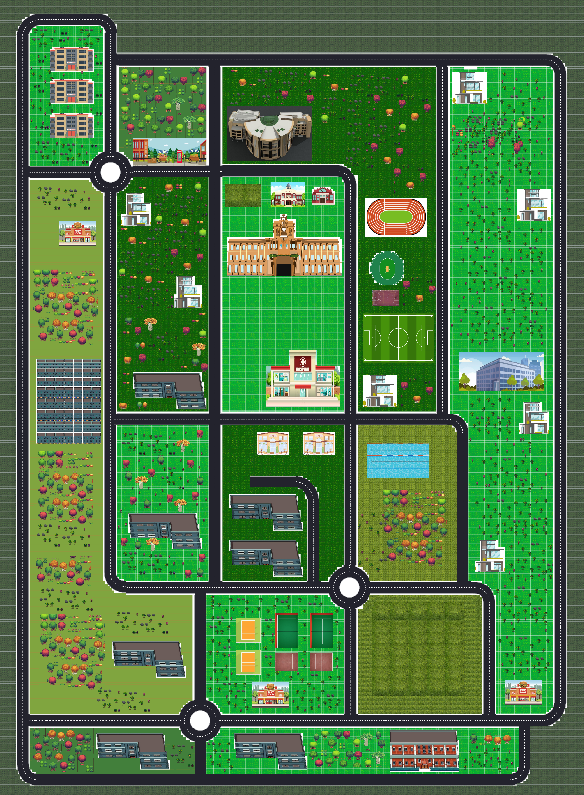
Map Snapshot and Explanation
We created this map using ‘Tiled’ and we tried to load the .tmx file in our map, we tried several different libraries for this purpose like raylilb-tiled raylib-tmx, raylib-tileson and all but all of them had some bug or the other. Then we thought that we can load the .png file of the map and thus we loaded it in the png format. The overall feel of the game was not impacted by this design decision. We downloaded various tilesets and images for this map. All of them from free sources only.

Slide 8
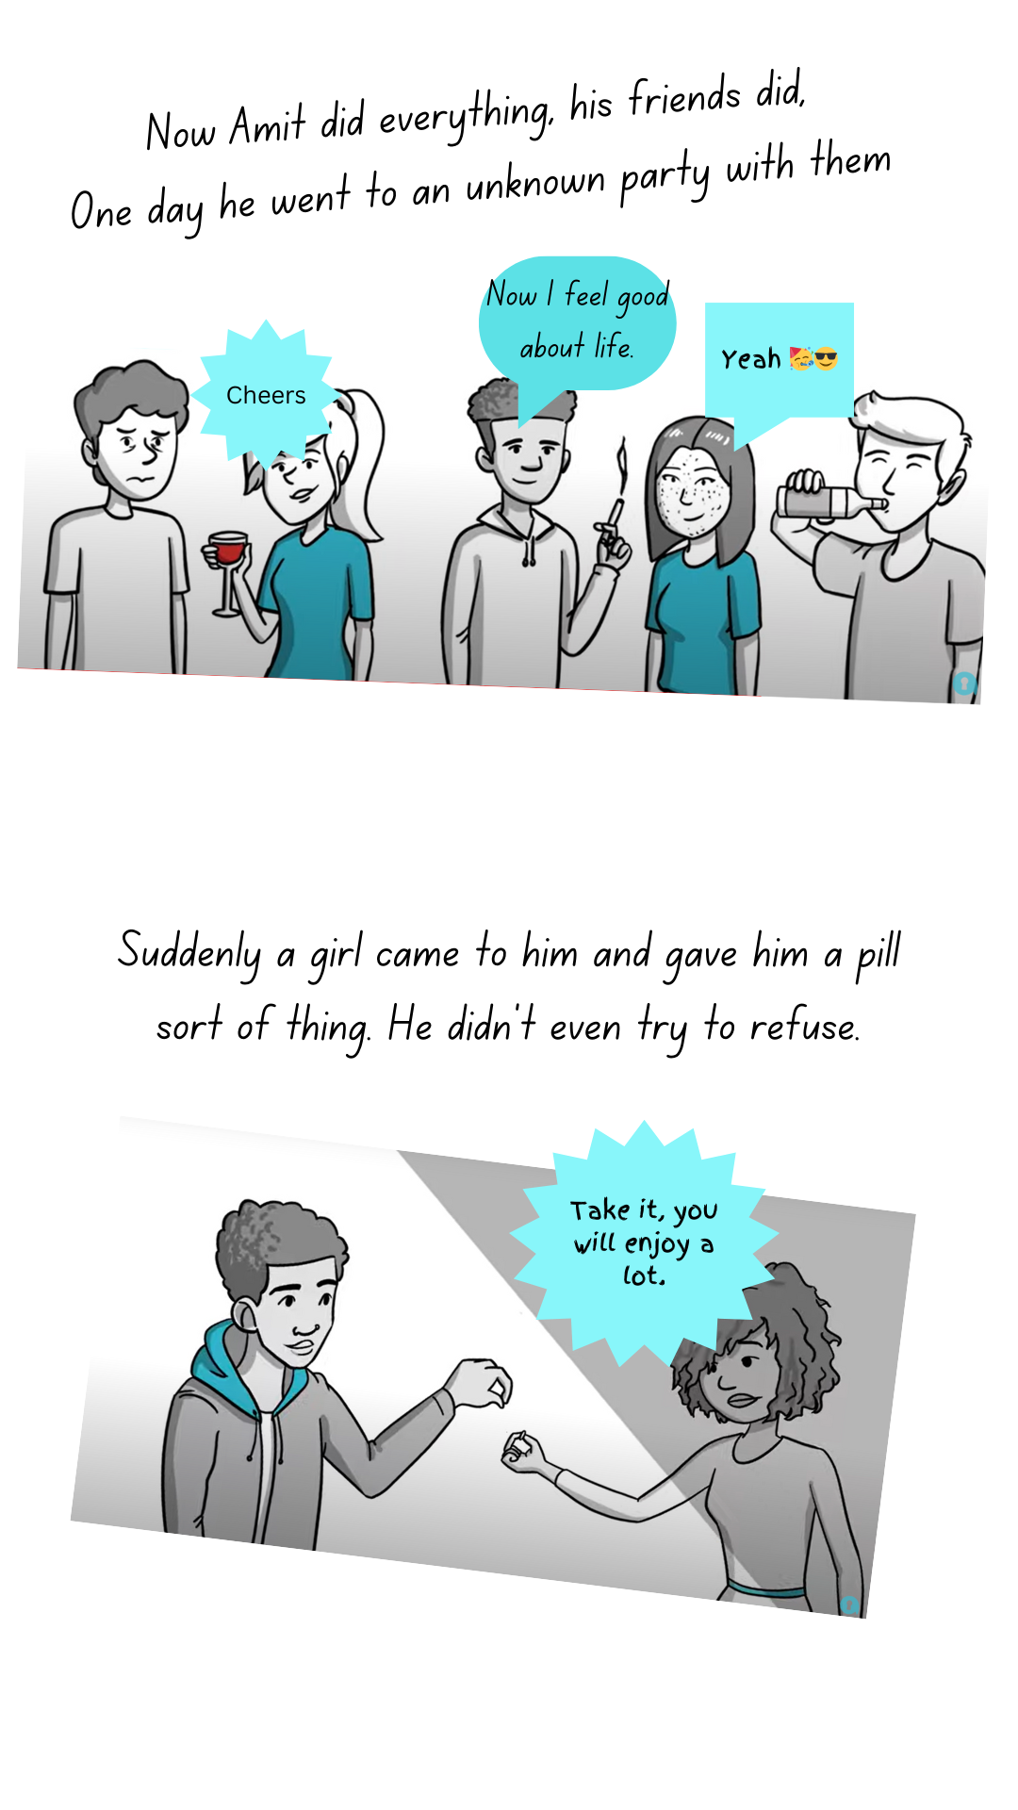
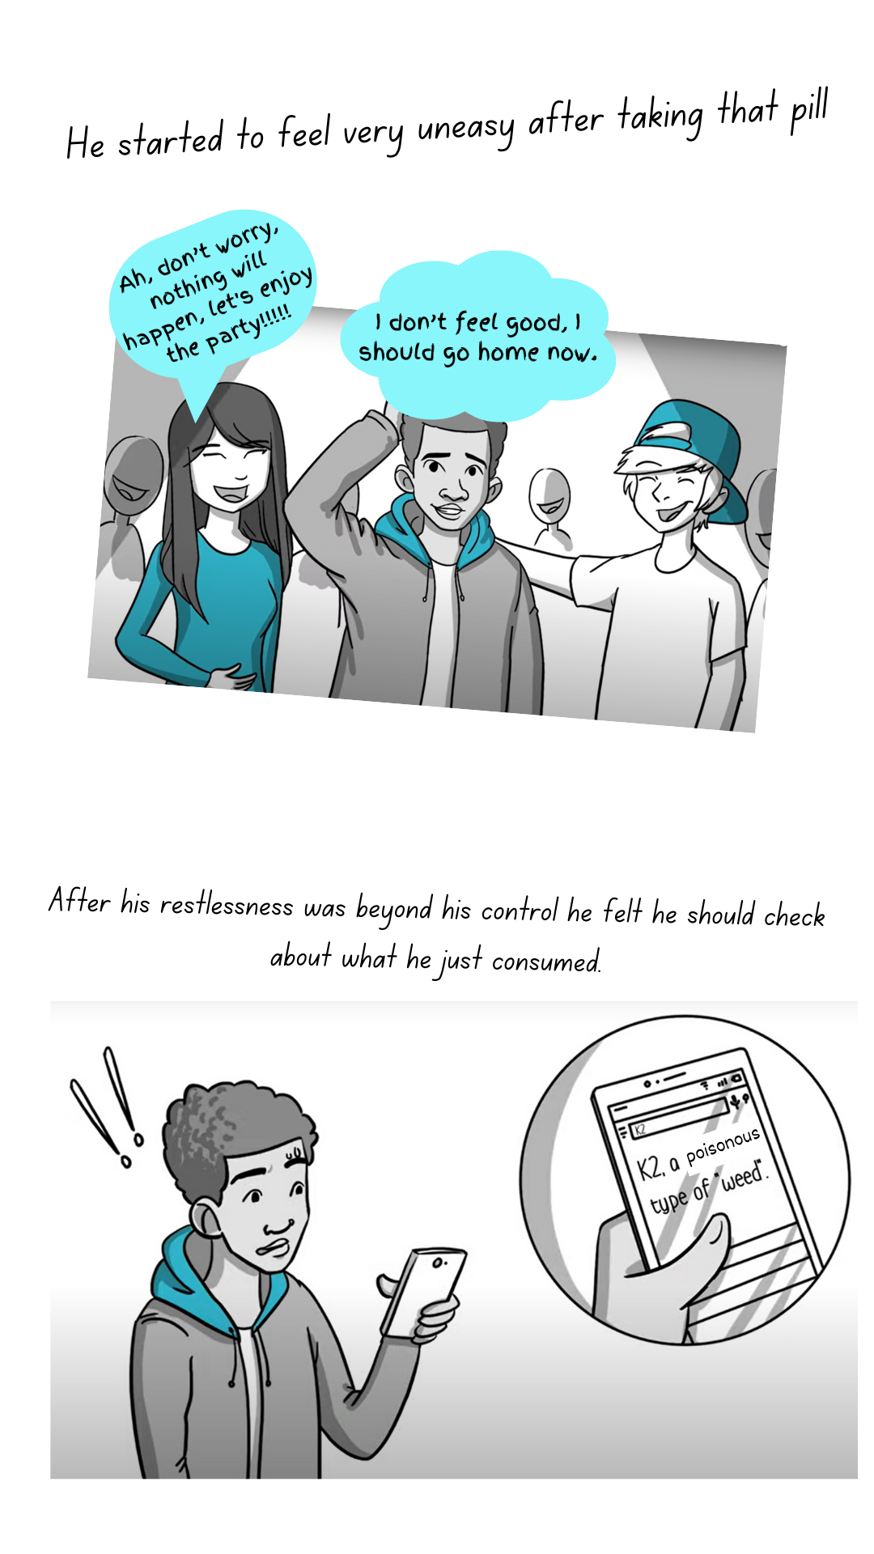
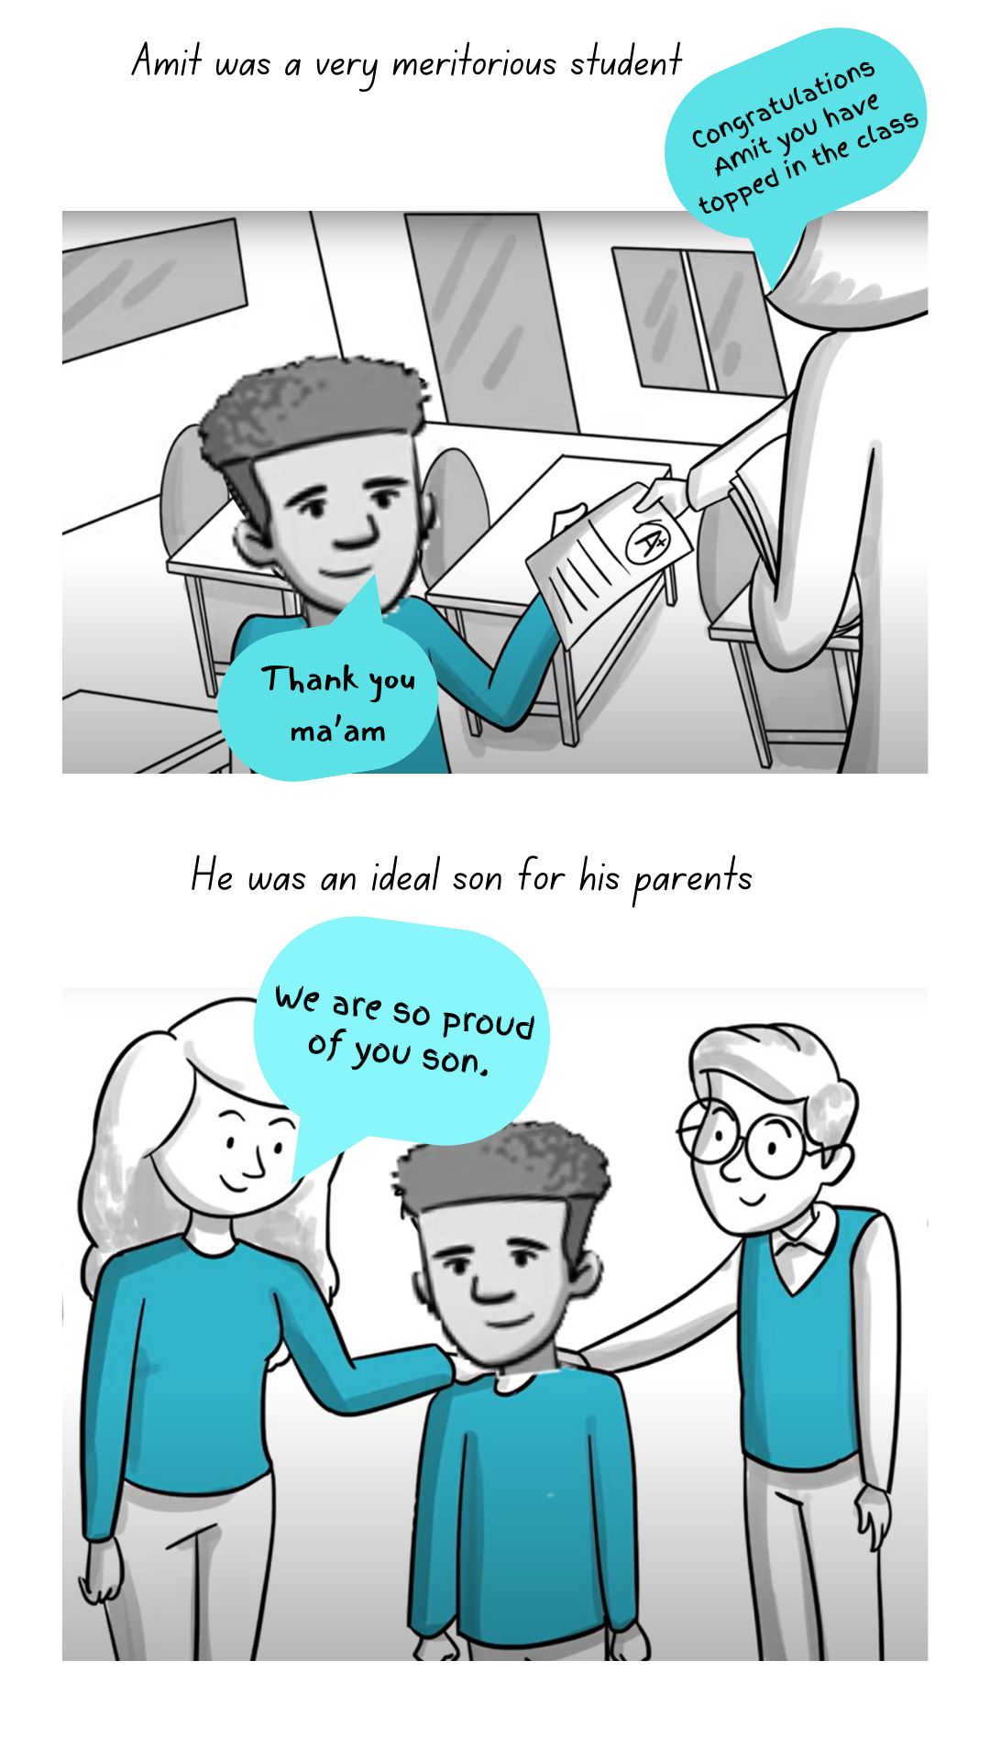
Some Backstory Snapshots

Slide 9
Structuring the code
Initially we started by making a raw game focusing only on movement of sprite and texture loading. But the code was very messy.
Hence abstraction and classification was needed –
CommandListener : Reacts to the commands
InputHandler : handles the input and transfers the it to the correct class
Actor : the characters and animated objects in game
Scene : Specifies which world/scene to currently run. Used for running different cutscenes and making the running game as a separate universe from rest. Same applies for all.

Slide 10
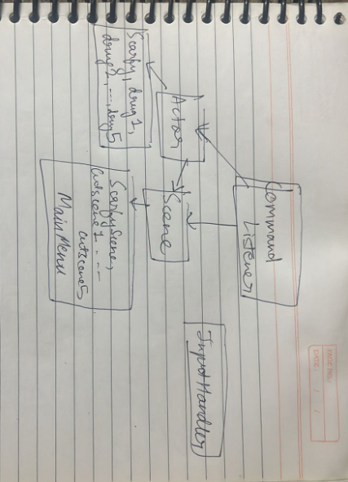
Structure for Relationship and hierarchy of classes

Slide 11
Collision Handling
As we stated earlier that we were not able to load map from tiled from any libraries in the .tmx format and thus loaded the map as .png file.
So in order to handle collision, we first checked the direction in which the Scarfy is supposed to go and then checked the color of the texture.
If the color of the RGBA value of the texture was exactly as that of the RGBA value of the road or the white line in the middle of the road, we moved scarfy and stop the hero in other case.

Slide 12
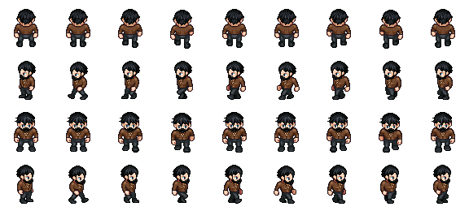
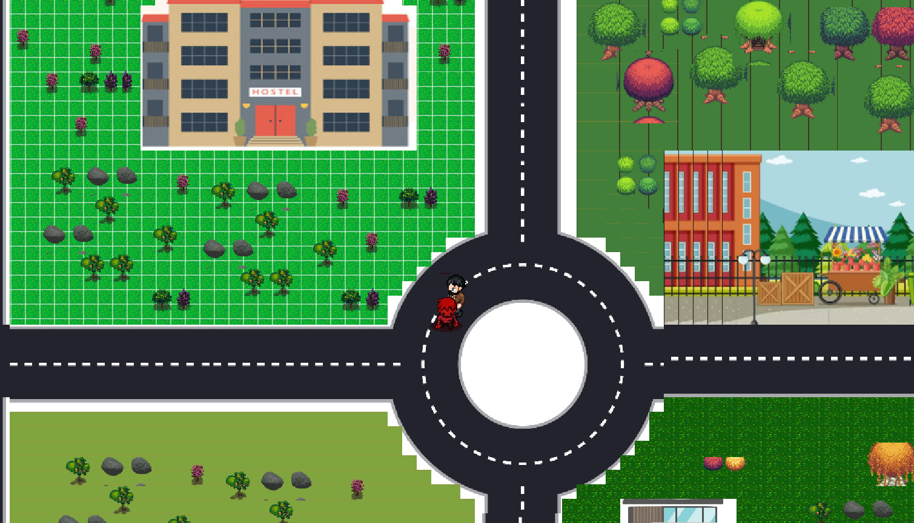
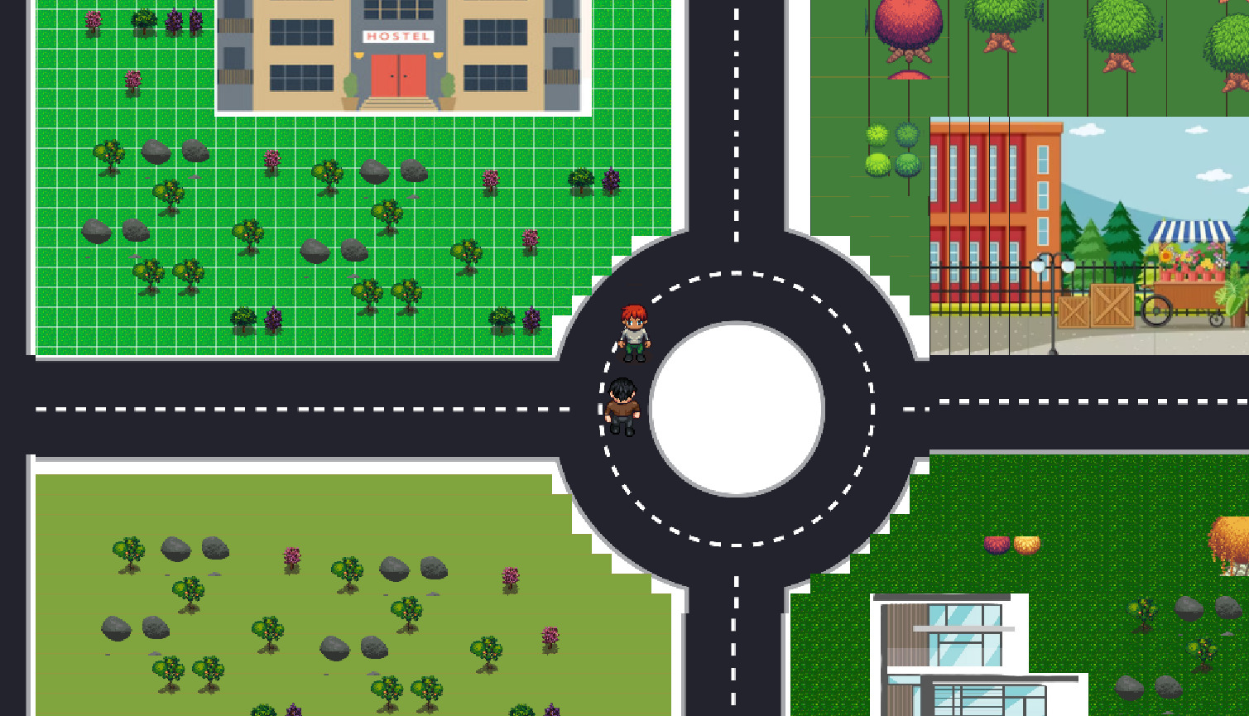
Some Snapshots of gameplay.

Slide 13
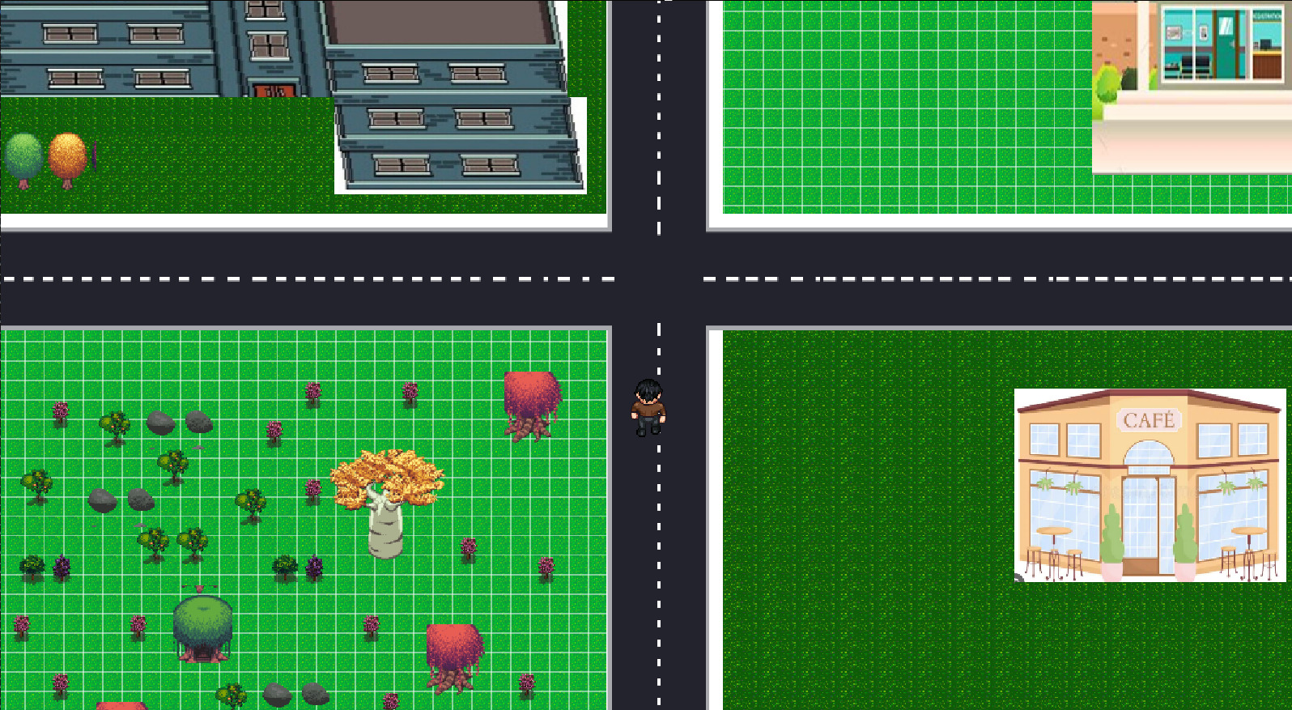
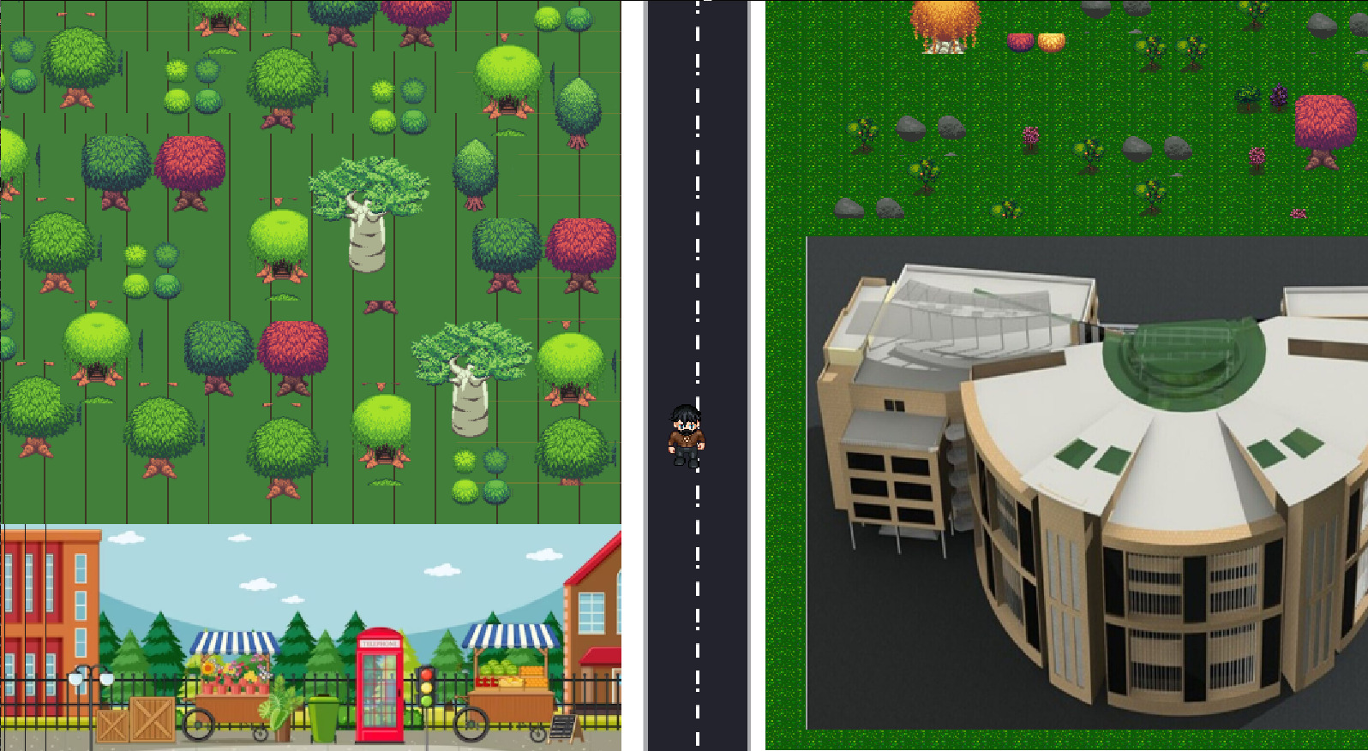
Snapshots…

